Slide 1


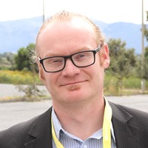


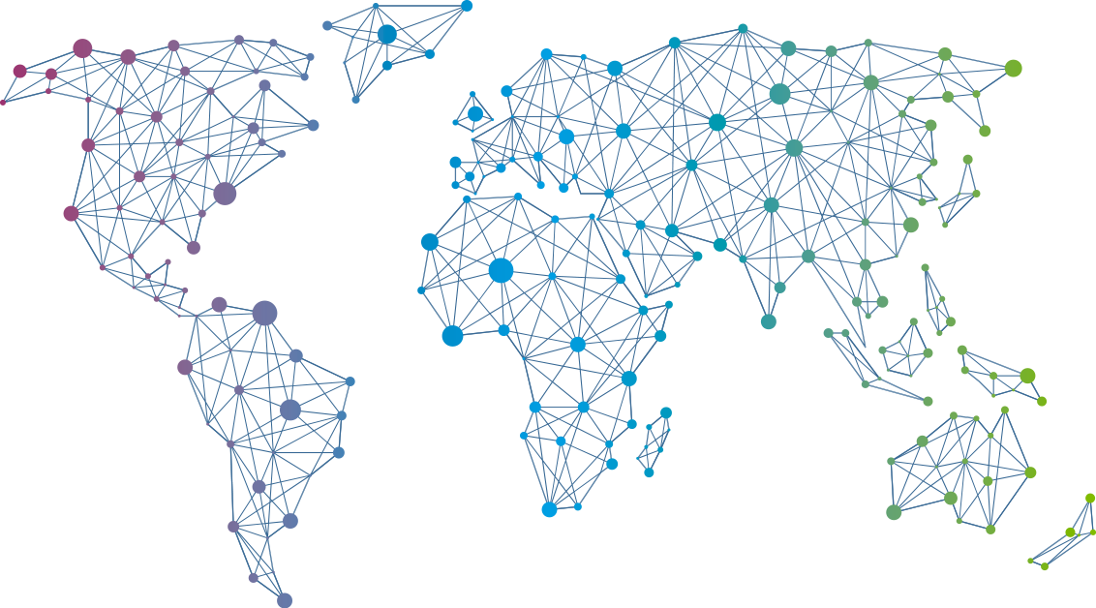
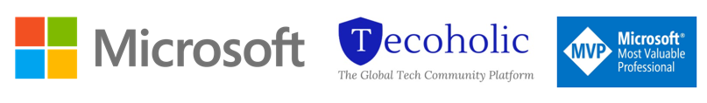
Speaker
Nestori Syynimaa
AADInternals: How did I built the ultimate Azure AD hacking tool from the scratch
Nestori Syynimaa
DrAzureAD
September 16th & 17th
^{Online Event}
Powered By
International Conference

